Slide 2
Market intelligence to Focus Dairy Producer Business Models on Customer Needs
Professor Geoff Simmons
Ulster University Business School

Slide 3
Business Models
Peter Drucker defined a Business Model as — “assumptions about what a company gets paid for” — which is part of Drucker’s “theory of the business.”
A good business model answers Peter Drucker’s age-old questions, ‘Who is the customer? And what does the customer value?’ It also answers the fundamental questions every manager must ask: How do we make money in this business? What is the underlying economic logic that explains how we can deliver value to customers at an appropriate cost?”

Slide 4
Business Models
I like to think of business models as two parts:
Part one includes all the activities associated with making something: designing it, purchasing raw materials, manufacturing, and so on.
Part two includes all the activities associated with selling something: finding and reaching customers, transacting a sale, distributing the product, or delivering the service.
For me and my work part two is key and indeed the rest of this presentation considers how to achieve this through MI integration into a firm’s marketing and innovation processes.

Slide 5
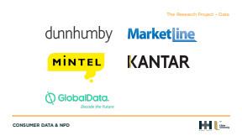

Slide 6
COVID and changing consumption
Dramatic changes in customer behaviour in numerous industrial sectors with desire for digital interactions and purchasing
Food consumption is moving online, with fewer store visits and demand for key items along with an increase in demand for fresh and healthy products (Deloitte, 2020; Mintel, 2020).
Studies call for a new strategic plan led by the UK Government to re-orientate the UK food system to sustainable domestic production (Garnett et al. 2020).
Deloitte and Mintel note that a resilient UK food industry will be based on capacity to respond to pandemic-driven consumption change with innovative new food products focused on areas such as health and wellbeing for example.

Slide 7
Less is More
Retailers
•Rationalisation of products
•Rationalisation of suppliers
•Rationalisation of buying teams
Suppliers
•Caught in the headlights or lost in the fog?
•If ever there was a need for strategic clarity it is now

Slide 8
The value of MI
•Informs
–Strategic planning
–Marketing planning
–NPD
•Supports
–Category management
•Enables
–Consumer segmentation
–Targeted resource allocation
–Relationship development

Slide 9
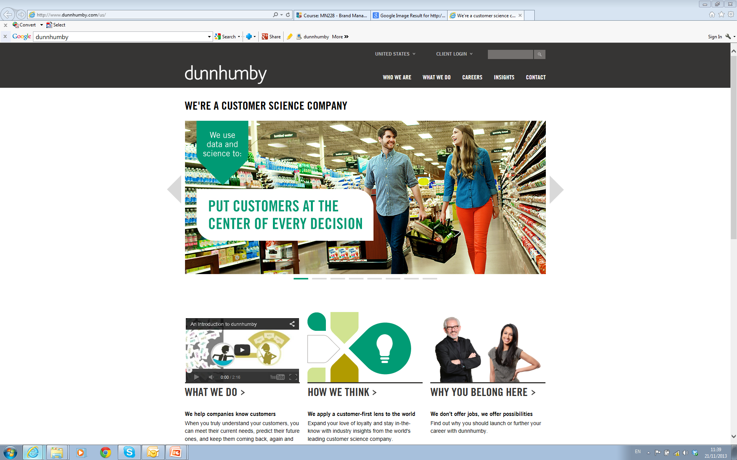

Slide 10
Dunnhumby UK – Clubcard data
Dunnhumby UK manage Tesco Clubcard shopper data, the largest behavioural database with respect to food and drink purchasing behaviour in the UK
This data accounts for a 10% sample (~2 million shoppers) of the 20million households who shop at Tesco and use their Clubcard
This data is then mined by around 500 dunnhumby data scientists using Artificial Intelligences and machine learning models to identify sub-groups of consumers based on shopper lifestyles
As such, Tesco Clubcard data provides unparalleled detail into who buys what and how food shoppers respond to marketing activities (e.g., in-store, on-line and on-pack).

Slide 11
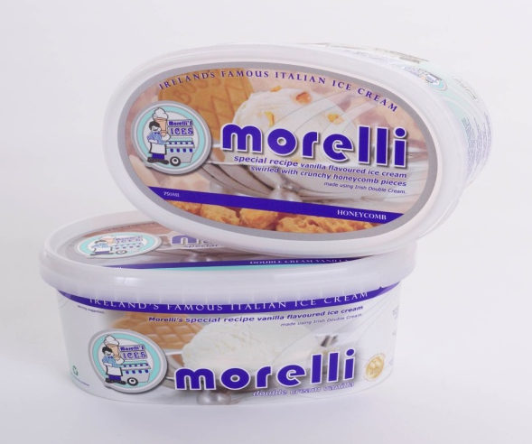

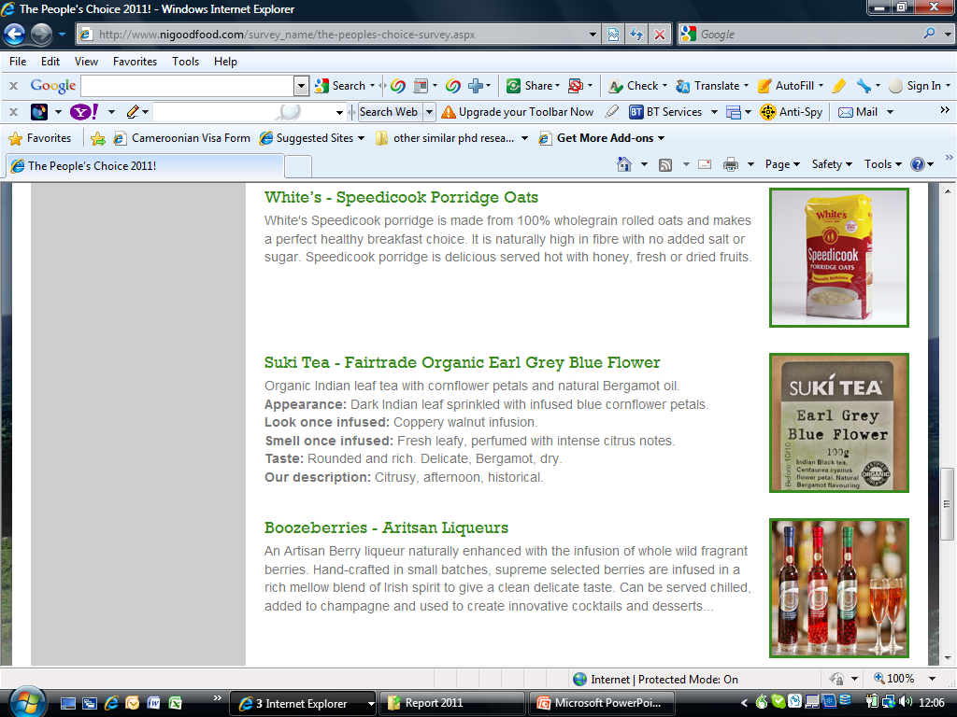
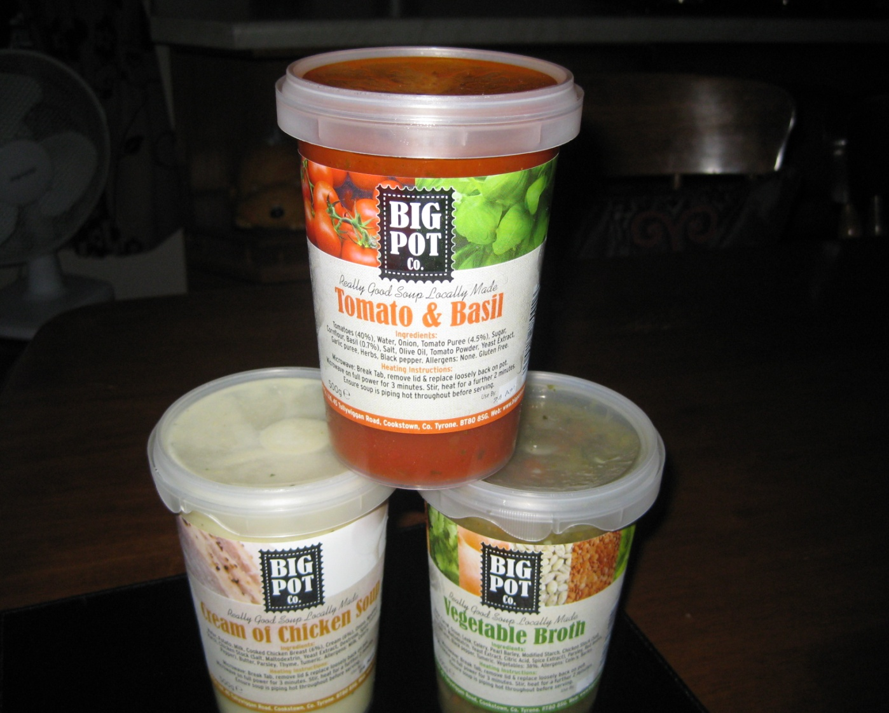
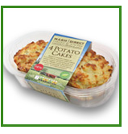
How NI Food Firms Have Used Clubcard data

Slide 12
Tesco Healthy Living Natural Greek Yoghurt

Slide 13
Importance of Capacity to Make Sense of data
The representativeness and unique insights provided into food shopper behaviour makes Tesco Clubcard the most expensive data to purchase.
Importantly, it is of no value to dairy producers if they do not have the capacity to make sense of it – data – information – knowledge.
The primary purpose of the Tesco Clubcard data is to support marketing planning and NPD of dairy producers.
Being a customer-led firm is important to creating innovative new dairy products that meet the needs of consumers.

Slide 14
Food marketing and innovation responses
Adding experiential components (emotional, sensory, relational and social experiences related to the purchase) to dairy products offers producers the opportunity to foster social connections with customers – e.g. social media, special events.
Experiential components adding value to dairy product need to precisely match the attitudes, interests and opinions of target customers.
Using STP and the four Ps, dairy firms offering experiential components to their food products have the opportunity to deepen customer involvement and create more enduring satisfaction.

Slide 15

MILKO - packaging design for premium Dairy Products. The main mood is luxury and it comes from dark red gold and white milk

Slide 16
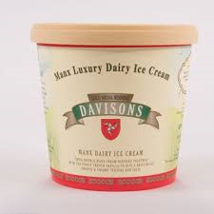
Luxury Branding
Premium

Slide 17
Data-driven NPD process
Dairy producers require access to MI to respond to enable targeted added value products at the correct consumer segments.
This needs to inform an NPD process that is responsive to fast moving food consumption opportunities.
Moving from an ad hoc approach to new product development (NPD) towards a systematic process informed by insight.
A consumer-centric NPD process to inform the key stages of the process.

Slide 18
